Slide 1
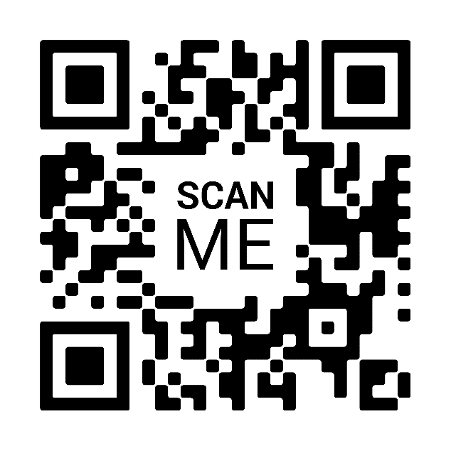
Race, Ethnicity, and Social Justice A virtual conference hosted by Sociology and Anthropology
SEPTEMBER 23, 2021
1:45 – 2:30 PM
Light refreshments provided
Via Zoom:
Cultural Memory and Survival in Colombia – A Work in Progress
VIRTUAL MEETING LINK
For interpreting services, please contact https://myaccess.RIT.edu.
Dr. Mesi Walton
Lecturer (Spanish), Dept. of World Languages and Cultures
Howard University, Washington D.C.
Ph.D. in African Studies, Howard University ‘19

